Slide 1
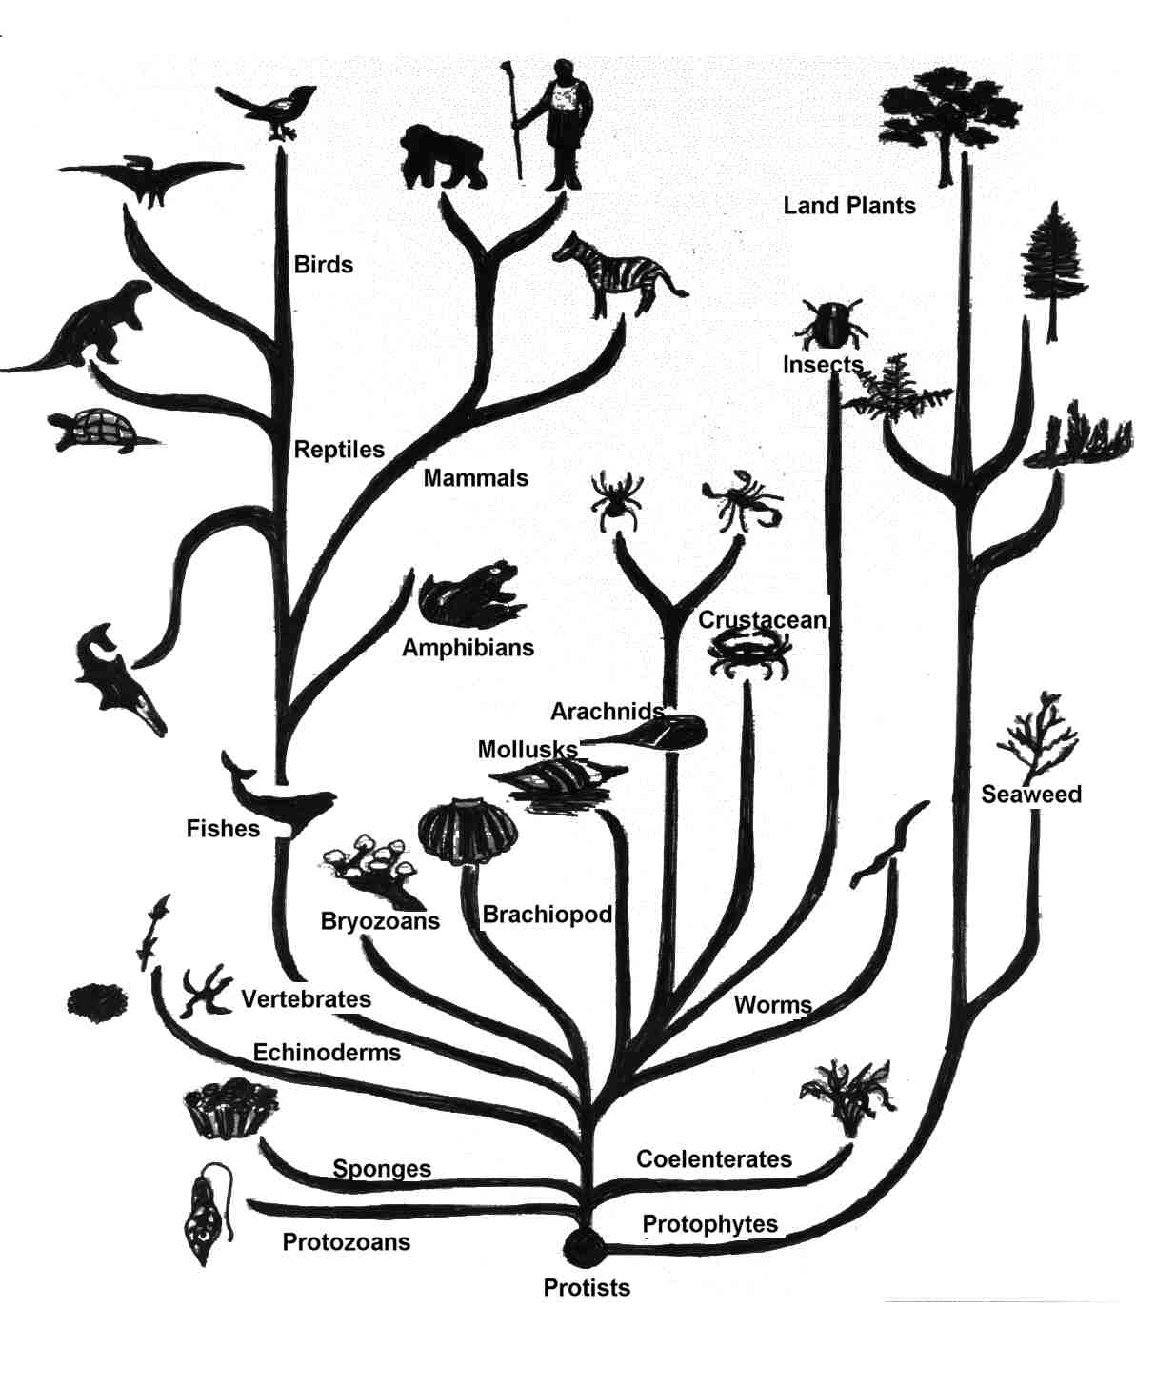
Taxonomy & Classification
Is there a pattern to life’s diversity?
Notes:
Taxonomy is the science of naming and classifying organisms.

Slide 2
Goals to Understand
Taxonomy is the system of classifying organisms.
  “Taxis” – arrangement, order
  “Nom” – law
Scientists use a standardized system to discuss organisms.
Relationships exist between organisms in the hierarchical classification system.

Slide 3
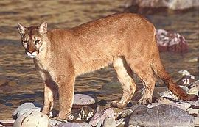
Why classify?
→To name organisms & group them in a logical manner.
→To avoid confusion caused by regional names.
Notes:
Puma, Cougar, Mountain Lion, Panther? All common names for the same animal.

Slide 4
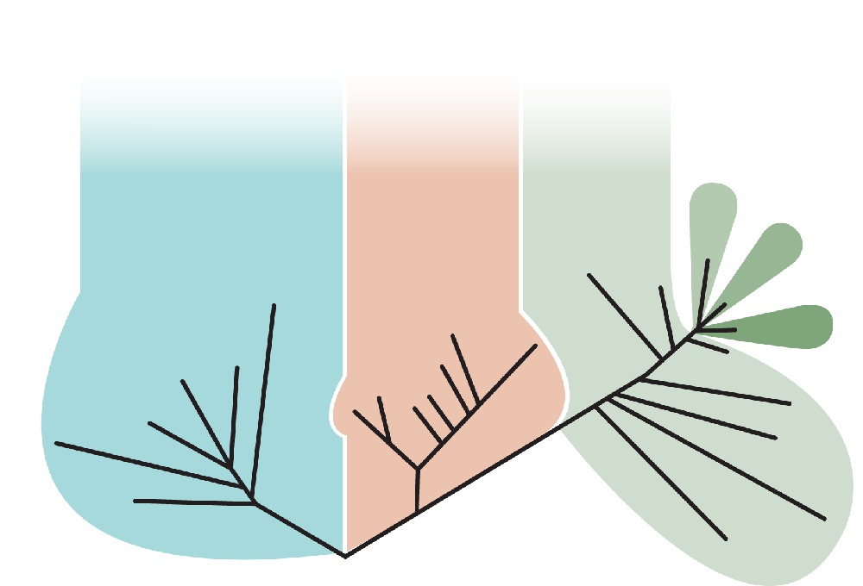
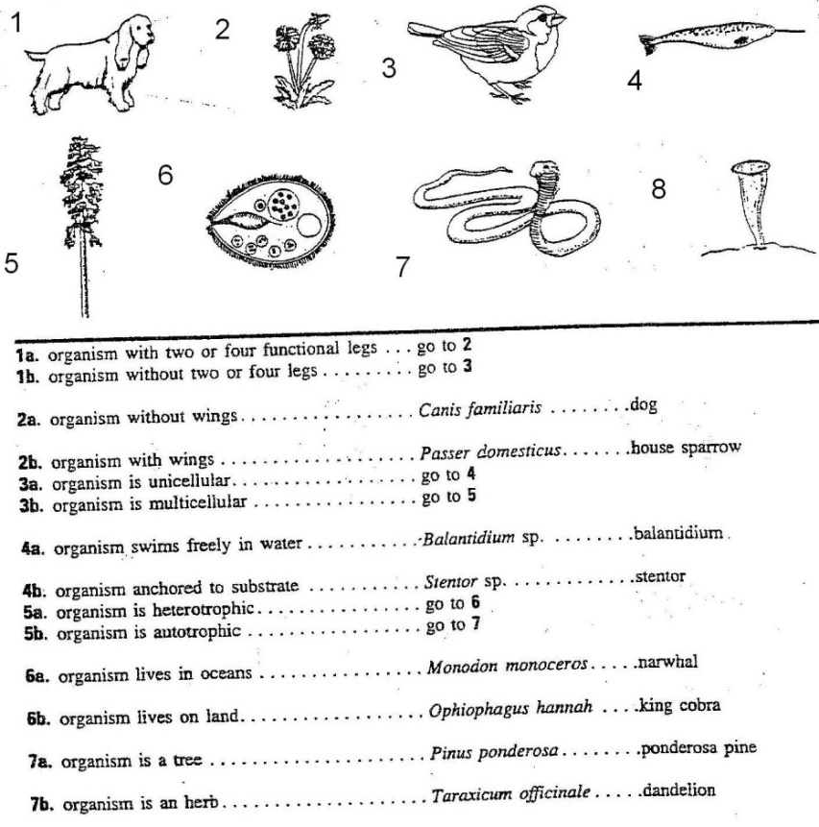

How are organisms classified?
Phylogenetic Tree
Based on ANCESTORS
Dichotomous Key:
Based on VISUAL TRAITS
DNA Analysis:
Based on GENETIC CODE
Notes:
By using these we can find that relationships exist btwn organisms in the hierarchal classification system

Slide 5
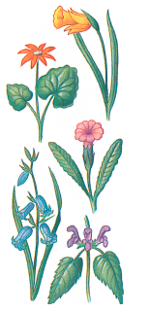
Dichotomous Key Practice
Determine the name
of the different flowers:

Slide 6
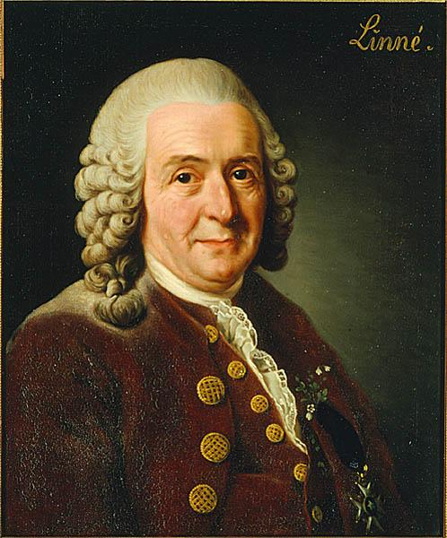
Linnaean Taxonomy
Carl Linnaeas – Father of Taxonomy
  Developed a classification & naming system
  for organisms that is still used today!
Each level is called a TAXON
The more taxons organisms share, the more closely related they are!

Slide 7
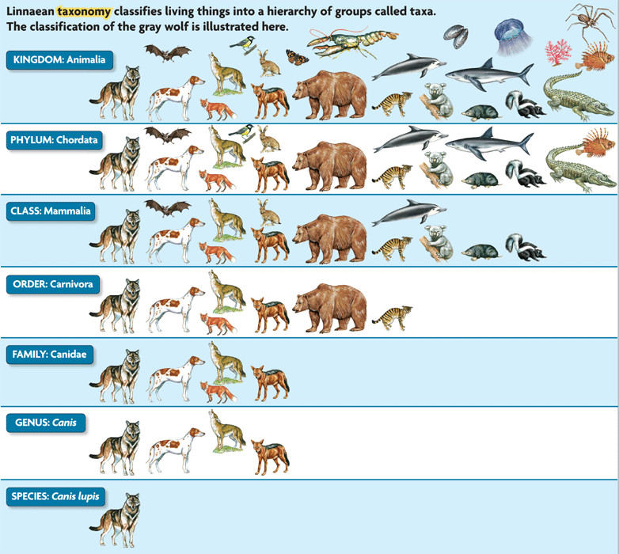
Linnaean Taxonomy
Broadest
Domain
Kingdom
Phylum
Class
Order
Family
Genus
Species
Specific

Slide 8
Mnemonic devices make it easy to recall the levels!
Domain Did
Kingdom King
Phylum Phillip
Class come
Order over
Family for
Genus Good
Species Spaghetti?

Slide 9
LIFE CHART!

Slide 10
Organism | Cat | Wolf | Fly
Kingdom | Animalia | Animalia | Animalia
Phylum | Chordata | Chordata | Arthropoda
Class | Mammalia | Mammalia | Insecta
Order | Carnivora | Carnivora | Diptera
Family | Felidae | Canidae | Muscidae
Genus | Felis | Canis | Musca
Species | F. domesticus | C. lupus | M. domestica
Which 2 animals are most closely related?
At what classification level do cats and wolves diverge (become different)?
Family
Cat and wolf

Slide 11

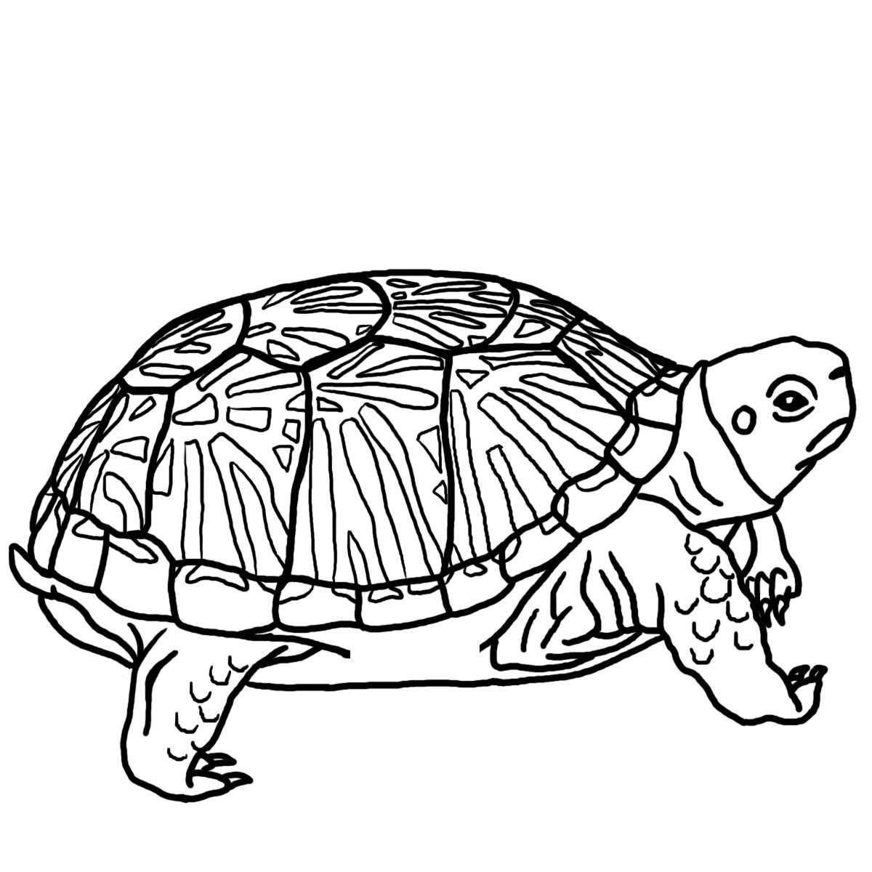
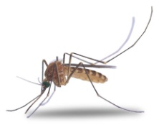
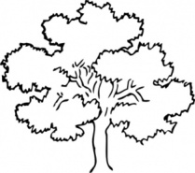
 | 1 | 2 | 3 | 4
Domain | Eukarya | Eukarya | Eukarya | Eukarya
Kingdom | Animal | Animal | Animal | Plant
Phylum | Chordata | Chordata | Arthropoda | Traecheophyta
Class | Mammalia | Reptilia | Insecta | Angiospermae
Order | Primates | Chelonia | Diptera | Fagales
Family | Hominidae | Emydidae | Culicudae | Fagaceae
Genus | Homo | Terrapene | Theobaldia | Quercus
Species | sapiens | carolina | anulata | alba
Which of the organisms is most closely related?
At what level of classification do the two organisms differentiate?

Slide 12
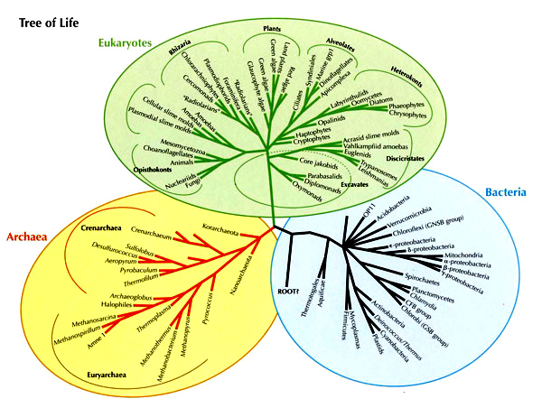
The 3 DOMAINS

Slide 13
The 3 DOMAINS
Archaea & Bacteria – All Prokaryotic Cells
  -REVIEW! Prokaryotic cells __________ have a nucleus.
Eukaryotes – All Eukaryotic Cells
  -REVIEW! Eukaryotic cells __________ have a nucleus.
These 3 Domains are divided into 6 Kingdoms, each Kingdom is divided into Phylums, and so on…

Slide 14
The 6 KINGDOMS
Some basic things that we start comparisons with at the level of Kingdom:
  Prokaryote or Eukaryote
  Unicellular or Multicellular
  Sexual or Asexual reproduction
  Autotroph, Heterotroph, or Decomposer
  Motile/mobile or immobile/nonmotile

Slide 15
The 6 Kingdoms
On your “Kingdoms Hand Print” page, trace your hand!!
Each finger will represent one (or two) kingdoms!

Slide 16
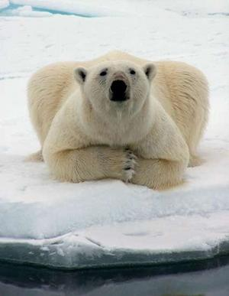
Binomial Nomenclature
→1st word = Genus
→2nd word = species
→Genus is ALWAYS capitalized, species is not
Ursus maritimus
→Entire name is either italicized or underlined
Notes:
-2 word naming system developed by Carl Linnaeaus
-Each organisms is given a scientific name, written in Latin, based on its genus and species

Slide 17
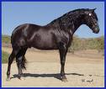
Which of the following is the correct scientific name of an organism?
equus caballus
Black stallion
Equus caballus
horse

Slide 18
Which organism is most similar to the sandhill crane, Grus canadensis?
Branta canadensis
Falcipennis canadensis
Grus americana
Recurvirostra americana

